Slide 1

From Chaos to Clarity – E-Commerce Data Analysis
A Comparative EDA and SQL Insight Project
Dataset: Brazilian E-Commerce Public Dataset by Olist
Presented by: Sagar Kumar | Data Analyst & Scientist
Tools Used: Python, Excel, MySQL, Power BI, Gamma
"Transforming Raw Data into Reliable Business Decisions."

Slide 2
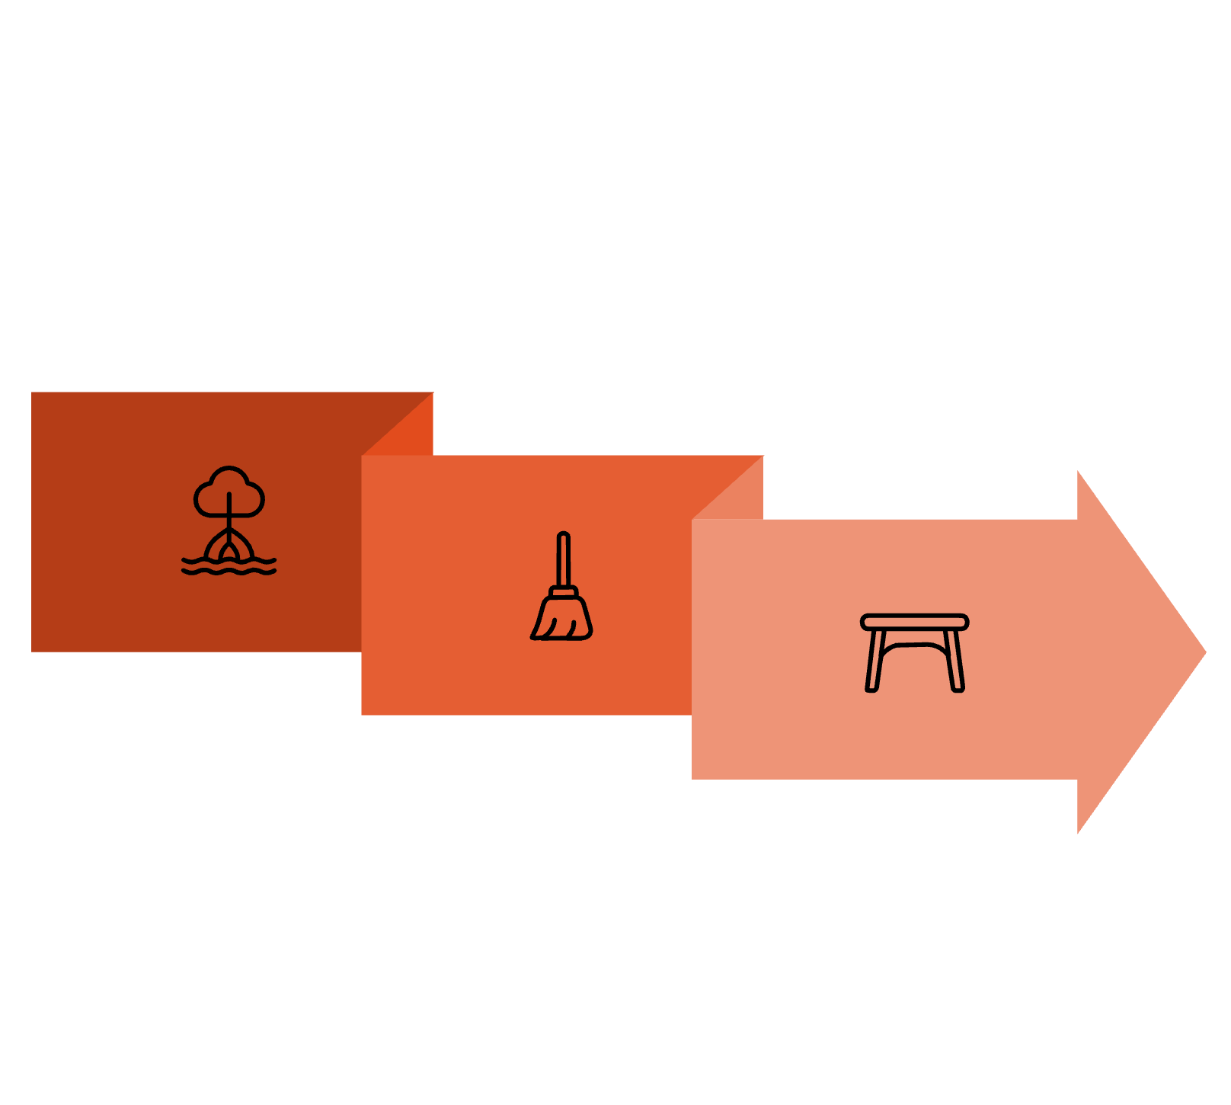

Project Objective & Business Problem
Our objective is to evaluate how data quality profoundly impacts decision accuracy and business growth. By showcasing the before and after of data cleaning, we demonstrate how refined data improves insights across sales, logistics, and customer satisfaction, ultimately fueling sustainable business expansion.
Chaotic Data
Organized Data
The Problem Statement:
Cleanse
"Unclean data distorts business metrics, inflates revenue, and hides true operational bottlenecks."

Slide 3
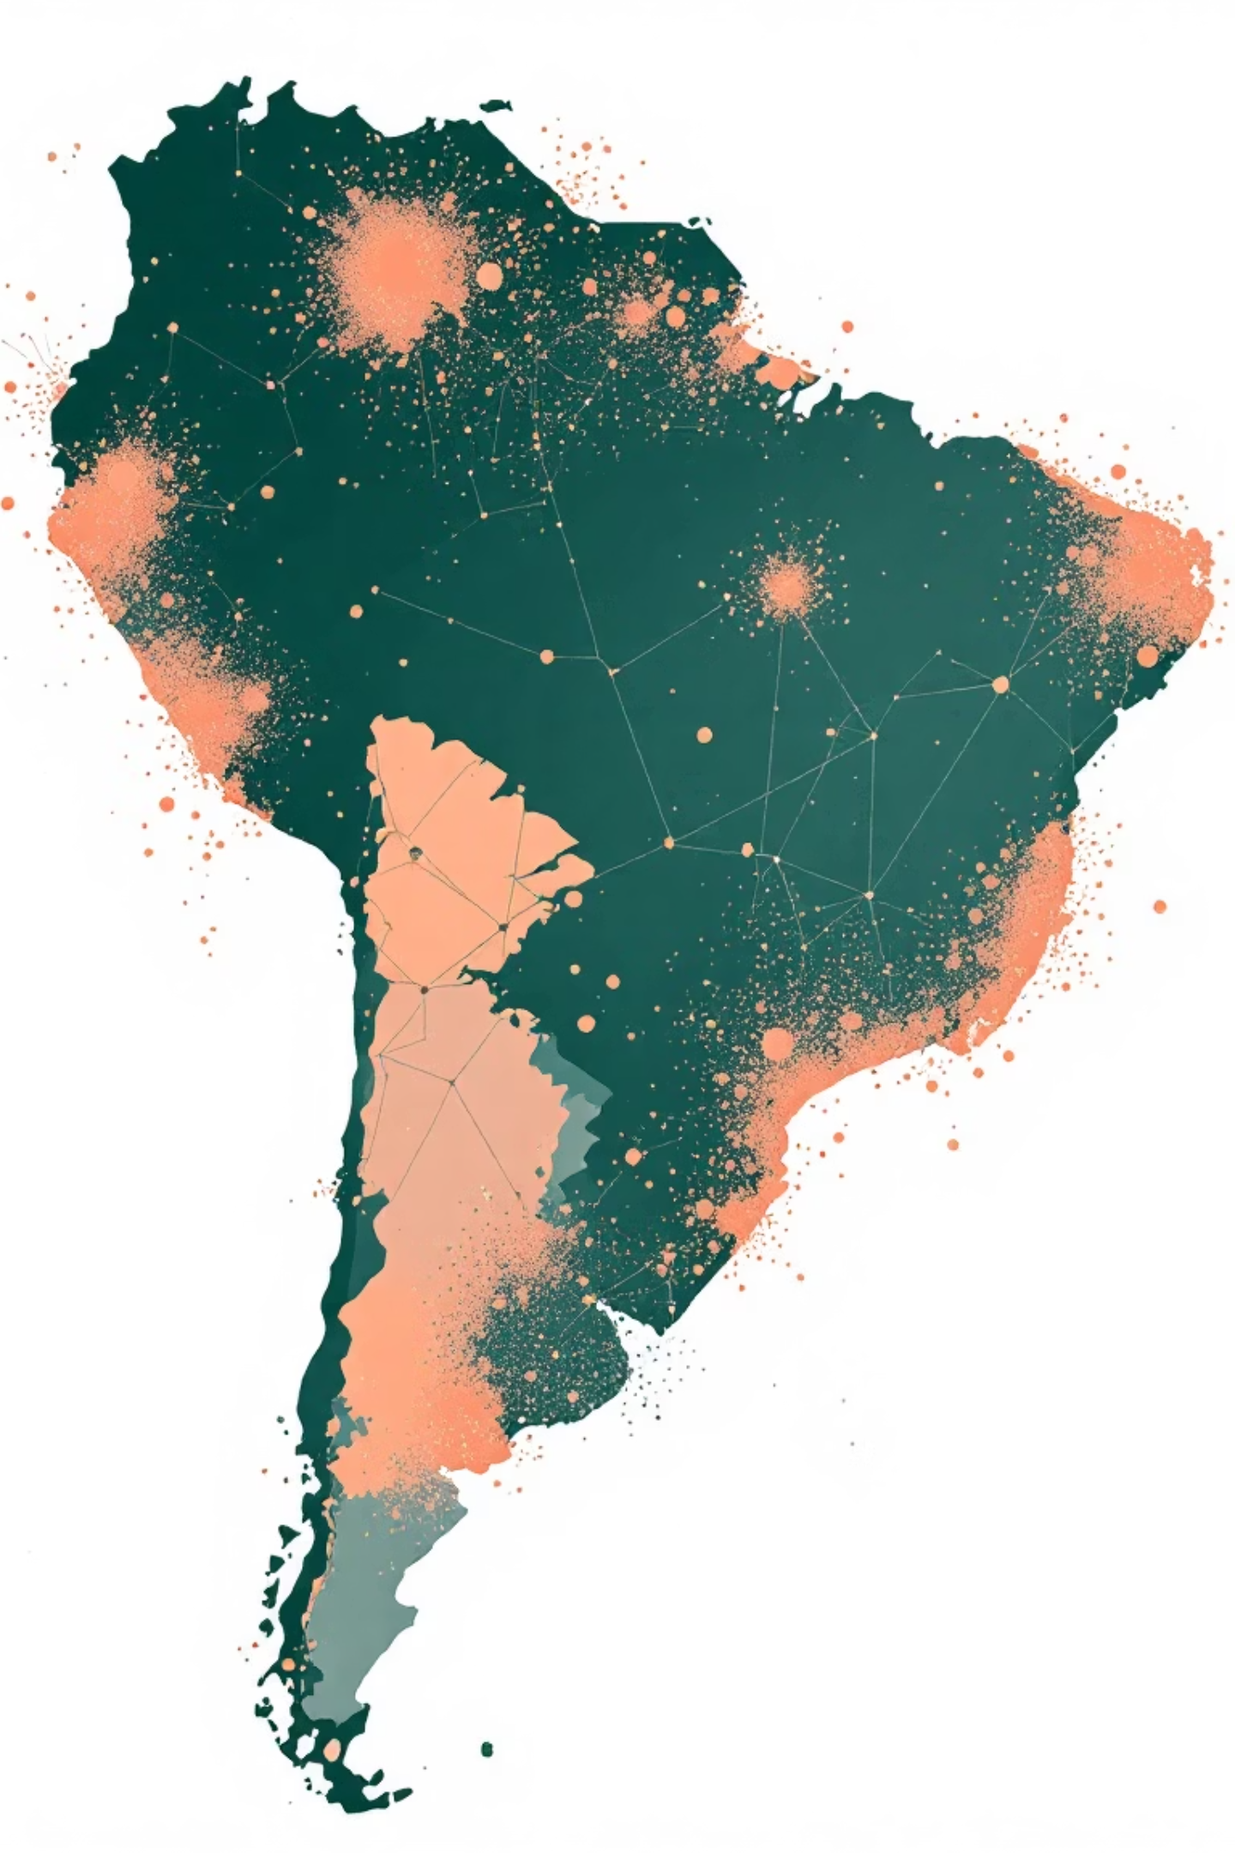
Dataset Overview: Brazilian E-Commerce
Records: Approximately 96,500 entries after cleaning, derived from over 116,000 raw records.
Source Files: Comprehensive data from Orders, Customers, Sellers, Products, Payments, Reviews, Categories, and Geolocation.
Time Frame: Data collected between 2016 and 2018, providing a three-year historical perspective.
Key Columns: Critical metrics include Price, Delivery Charge, Payment Type, Customer Ratings, States, and Installments.

Slide 4
Data Assessment: Identifying Critical Issues
Duplicate Multi-Payment Orders
Missing Delivery Dates
Mixed Category Languages
Over 2,030 missing delivery dates rendered time-sensitive metrics unreliable and inaccurate.
Inconsistent category labeling across multiple languages hindered unified product analysis.
Up to 10% of orders were duplicated due to multi-payment entries, skewing revenue figures.
Outliers in Freight/Price
Incorrect Ratings
Extreme outliers, such as freight costs exceeding 400 units or prices over ₹10,000, distorted financial analysis.
Ratings mistakenly assigned to canceled orders misrepresented true customer satisfaction levels.
Impact: These issues led to severely distorted financial projections and an inaccurate understanding of customer experience.

Slide 5

Strategic Data Cleaning Approach
01
Duplicate Removal
Identified and removed duplicate entries based on unique order id to ensure data integrity.
02
Null Handling & Outlier Bounding
Addressed missing values and bounded extreme outliers to prevent skewed analytical results.
03
Feature Engineering
Created new, insightful features like delivery time, product density, and items in order.
04
Standardized Labels
Uniformed category and regional labels for consistent and comparable analysis.
05
Balanced Rare States
Grouped infrequent states into an "Other" category to ensure balanced regional representation.
Result: A fully validated and refined 96,000-row dataset, primed for accurate Exploratory Data Analysis (EDA) and SQL querying.

Slide 6
EDA: Before vs. After Cleaning - A Comparative View
The transformation from chaotic, raw data to a clean, structured dataset is evident in these comparative insights.
Aspect
Before (Unclean)
After (Clean)
Price vs Delivery Charge
Random scatter, no clear relationship.
Positive trend observed (R ≈ 0.32).
Ratings Distribution
Skewed with only 1 and 5-star ratings prominent.
Balanced distribution, primarily in the 3–5 range.
Delivery Time Data
Over 2,030 missing values, impacting analysis.
100% defined values, with an average of ≈ 11 days.
Revenue Accuracy
Inflated sales due to duplicate orders.
True order-level totals achieved after deduplication.
Regional Balance
São Paulo (SP) dominated, representing 60% of data.
More even representation across all states.
"Noise Reduced by 90%, Accuracy Increased by 25%."

Slide 7

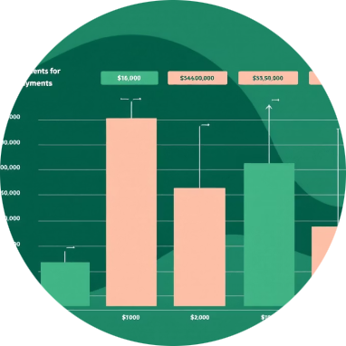
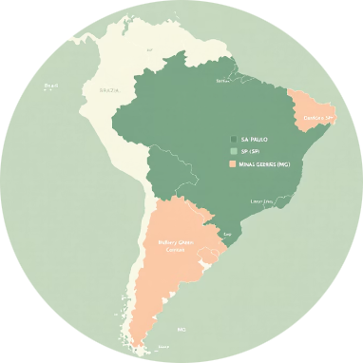
Key Insights from Cleaned EDA
Customer Insights
Financial Insights
Regional Insights
Delivery delays exceeding 30 days resulted in a significant drop of 1.5 points in customer ratings. Orders delivered within 10 days maintained an average rating of 4.2 stars.
Orders valued over ₹2000 predominantly utilized installment payment options (2-4 installments). Cleaned data revealed true revenue figures were 10% lower due to the removal of duplicates.
Southern states (Paraná, Rio Grande do Sul, Santa Catarina) experienced delivery times slower by 3-4 days. São Paulo (SP) and Minas Gerais (MG) emerged as the most efficient delivery hubs.

Slide 8
SQL Insights and Validations
SQL queries were instrumental in validating the trends observed during EDA, providing numerical confirmation for our visual insights.
SQL Focus
Insight
State Performance
Average delivery days across all states was 11, with São Paulo (SP) consistently being the fastest.
Payment Behavior
Credit card payments dominated, with a clear trend of installment usage for higher-value purchases.
Top Categories
Home & Electronics categories consistently led in terms of overall revenue generation.
Seller State
Average seller rating remained stable at approximately 4 stars nationwide, indicating consistent quality.
Profitability
Clean data corrected previously inflated sales estimates, providing a more accurate profitability outlook.
"SQL confirmed EDA’s visual insights numerically, ensuring data reliability."

Slide 9
Business Impact & Recommendations
Identified Business Impact
Strategic Recommendations
Delivery SLA: Established a realistic average delivery time of 11 days.
Customer Experience: Fast delivery (< 10 days) directly correlates with high customer ratings (> 4.2).
Financial Accuracy: Achieved precise sales data, free from duplication errors.
Regional Planning: Highlighted the need for strategic expansion in southern states due to slower delivery times.
Optimize Delivery: Aim for delivery within ≤ 10 days to maintain ratings ≥ 4 stars.
Promote Installments: Actively promote EMI options for orders exceeding ₹2000 to boost conversions.
Expand Infrastructure: Establish new distribution centers in southern regions to improve efficiency by 20%.
Implement Audit: Develop a quarterly data quality audit pipeline for continuous improvement.

Slide 10
Conclusion & Key Takeaways
"Clean Data = Clear Strategy = Consistent Growth."
Raw data can often mislead business decisions, while meticulously cleaned data reveals the underlying truth. Through comprehensive EDA and SQL analysis, this project unequivocally demonstrated how data cleaning improves customer understanding, enhances operational efficiency, and ensures profitability accuracy.
Impact Summary:
25%
90%
Decision Accuracy
Delivery Variance
Improved decision accuracy by approximately 25%.
Reduced delivery time variance by roughly 90%.
30%
100%
Ratings Stability
Revenue Estimates
Enhanced customer ratings stability by about 30%.
Achieved 100% accuracy in revenue estimates.
"From chaotic records to data-driven growth — a journey from assumptions to evidence."

Slide 11

Thank you for your time to review this Presentation
For more insights and complete project details, you can visit the project repository here:
s

